Slide 1

CSET 150
Network Design and Management
Evening Masters Edition
Dr. Mahboob Qaosar
Associate Professor, CSE, RU

Slide 2
Switching Design Considerations
We Know:
the hierarchical network design model and
the Enterprise Composite Network Design model
Hierarchical ..: the access layer, the distribution layer, and the core layer
Enterprise Composite Network ..: Enterprise Campus, Enterprise Edge, and Service Provider Edge.
Each of these functional areas contains network modules, which in turn can include the hierarchical layers.

Slide 3
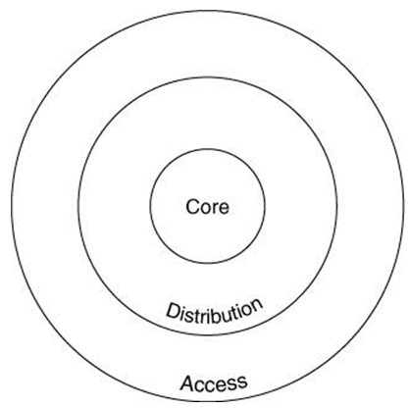
FOR THE ACCESS LAYER
For the access layer, design considerations include the following:
The number of end-user devices to be supported
The applications that are being used this defines some of the features required in the switches, as well as the performance and bandwidth needed
The use of VLANs, including whether trunks are required between switches
Redundancy requirements

Slide 4
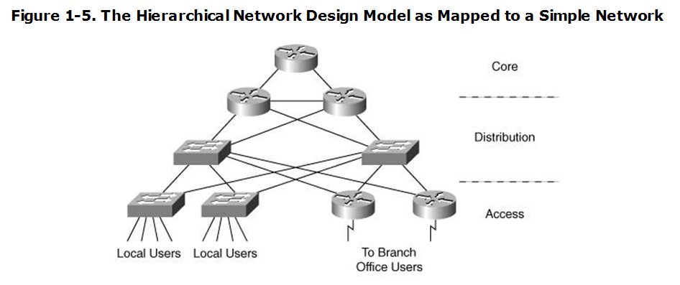
FOR THE DISTRIBUTION LAYER
For the distribution layer, design factors include the following:
The number of access switches to be aggregated
Redundancy requirements
Features required for specific applications to be supported
Required interfaces to the core layer
For Layer 3 switches, the routing protocols to be supported and whether sharing of information among multiple routing protocols is required

Slide 5
FOR THE CORE LAYER
The role of the core layer is to provide a high-speed backbone.
Thus, the key requirement is the performance needed to support all the access and distribution data.
The number of ports to the distribution layer, and the protocols (for example, routing protocols) that need to be supported on those ports, are also important considerations.
Redundancy in the core is a typical requirement, to meet the availability needs of the network

Slide 6

CISCO RECOMMENDATIONS
Cisco current campus design recommendations include the followin:
Layer 2 switches can be used at the access layer, with Layer 3 switches at the distribution and core layers.
VLANs should not spread across the campus, because this can slow network convergence.
The core and distribution layers can be combined into one layer (called a collapsed backbone) for smaller networks.
Larger campuses should have a separate distribution layer to allow the network to grow easily.
Redundancy in the core, between the core and distribution layers, and between the distribution and access layers is also recommended.

Slide 7
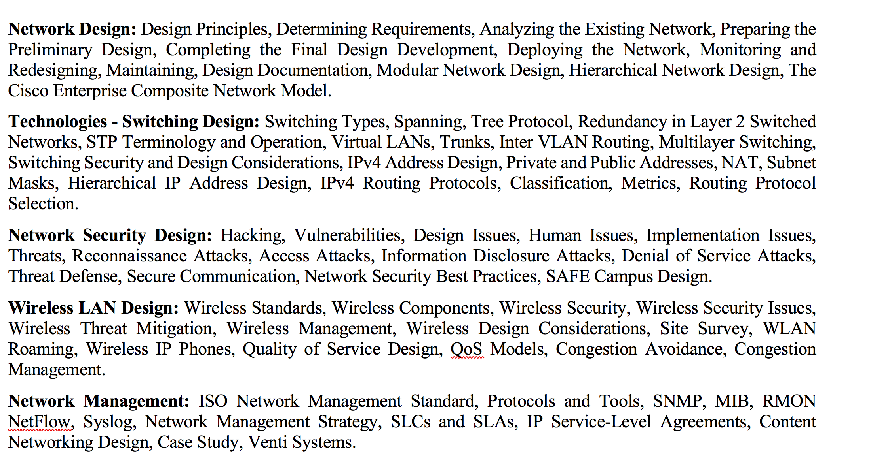
Chapter 3: IPv4 Routing Design

Slide 8
IPv4 Routing Design
Determining How Many IP Addresses Are Required
How many different locations in your network that need addresses: headquarters, branch and regional offices, telecommuters, and so forth.
The number of devices in each location must be counted, including:
the network devices such as routers, switches, and firewalls;
workstations;
IP phones;
network management stations;
servers; and so forth.

Slide 9
IPv4 Address Design
For each of these devices,
determine how many interfaces need to be addressed and
whether private or public addresses will be used.
Reserved address required 🡪 how many
10% to 20% suggested.
Problem: what if no reserved address available…

Slide 10
Private and Public Addresses
Requests For Comments (RFC) 1918,
"Address Allocation for Private Internets," defines the private IPv4 addresses as follows:
10.0.0.0 | To | 10.255.255.255
172.16.0.0 | To | 172.31.255.255
192.168.0.0 | To | 192.168.255.255

Slide 11
Private and Public Addresses
Private addresses are for use only within a company's network;
Public addresses must be used when communicating on the public Internet.
Internal private addresses must be translated to public addresses when data is sent out to the Internet, and these public addresses must be translated back to the private addresses when packets come in from the Internet.

Slide 12
Private and Public Addresses
Public addresses are required for the Internet connections and for servers that must be accessible from the Internet
for example, File Transfer Protocol (FTP) servers that contain publicly accessible data, and web servers.
Other devices internal to the network can use private addresses they can connect to the Internet through a NAT device.
NAT – network address translator

Slide 13
NAT (Network Address Translator)
To configure NAT 🡪 you first define inside and outside interfaces on the NAT device.
The inside interface connects to the internal network,
while the outside interface connects to the Internet.
You also define the addresses that are to be translated on each side.

Slide 14
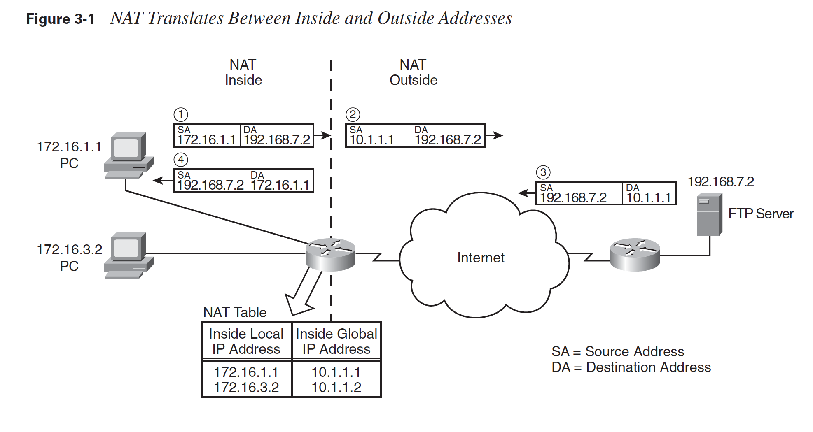
NAT
A person at PC 172.16.1.1 wants to access data on the FTP server at 192.168.7.2.
A NAT device (in this case, a router) translates addresses on the inside network 172.16.0.0 to addresses on the outside network 10.1.0.0
N.B.: In practice, public addresses would be used on the Internet

Slide 15
NAT
A NAT device has a NAT table,
created either dynamically or with static entries
configured by the network administrator
Simple NAT table in the NAT router includes :
Inside local IP address
The address used by a host on the inside network
Inside global IP address
The address that represents an inside host on the outside network

Slide 16
How Routers Use Subnet Masks
When you configure the IP address of a router's interface, you include the address and the subnet mask.
The router uses this information not only to address the interface but also to determine the address of the subnet to which the interface is connected.
The router then puts this subnet address in its routing table, as a connected network on that interface.

Slide 17
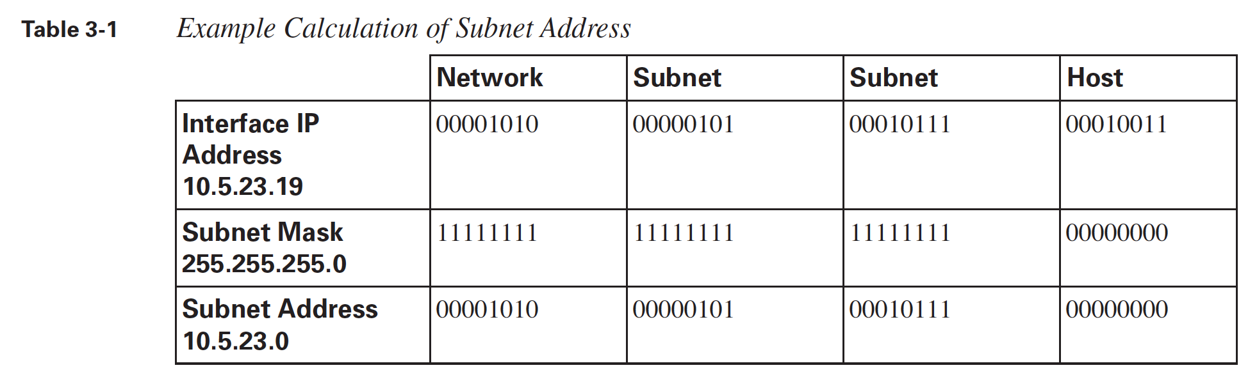
How Routers Use Subnet Masks
To determine the network or subnet address to which a router is connected, the router performs a logical AND of the interface address and the subnet mask. Logically "ANDing" a binary 1 with any number yields that number; logically "ANDing" a binary 0 with any number yields 0.

Slide 18
How Routers Use Subnet Masks
When a packet arrives at the router,
the router analyzes the destination address of the packet to determine which network or subnet it is on.
The router looks up this network or subnet in its routing table to determine the interface through which it can best be reached;
the packet is then sent out of the appropriate router interface.
[If the router does not have a route to the destination subnet, the packet is rejected and an Internet Control Message Protocol (ICMP) error message is sent to the source of the packet.]

Slide 19
Subnet Mask to Use
Determining the Subnet Mask to Use
… depends on the number of subnets required and
the number of host addresses required on each of these subnets

Slide 20
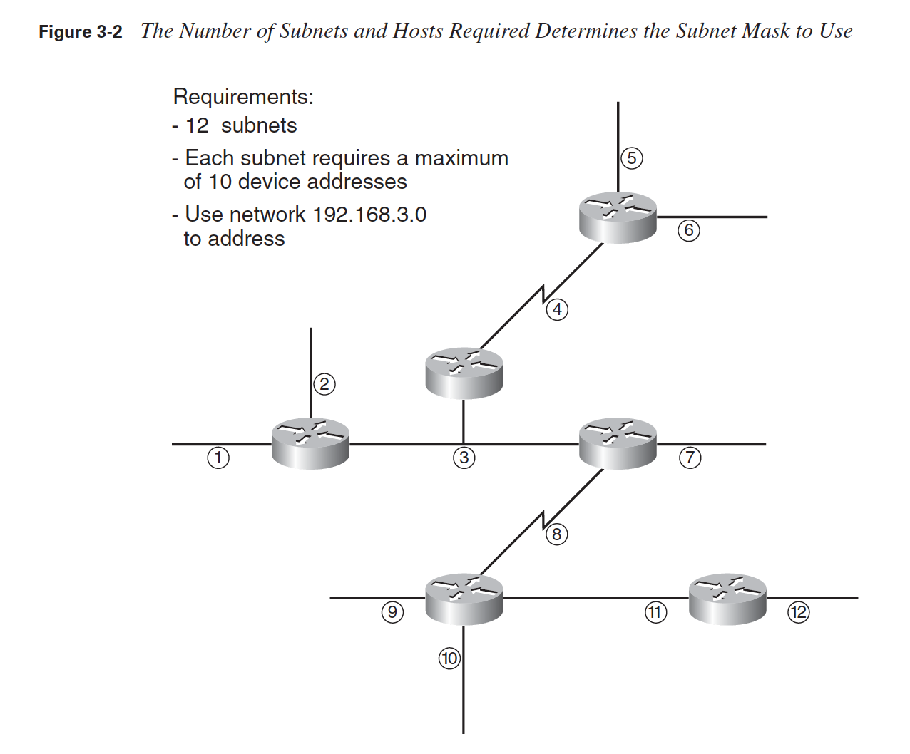
Determining the Subnet Mask to Use
A total of 12 subnets exist in this network;
Each has a maximum of 10 device addresses.
Some of the addresses are for router interfaces and some are for hosts (not shown in the figure);
each device on each subnet needs to have its own IP address.
Select a series : say 192.168.3…

Slide 21
Determining the Subnet Mask to Use
Number of subnet required 🡪 12 🡪 2^4 🡪 4 bits needed
Number of host address required 🡪 10 🡪 2^4 🡪 4bit needed
IPv4 🡪 32 bit – 8 bit . 8 bit . 8 bit . 8 bit
8 bit . 8 bit . 8 bit . 4 bit (Subnet) + 4 bit (Host)
255. 255 . 255. 1111000 🡪 255.255.255.240 – network mask or subnet mask

Slide 22
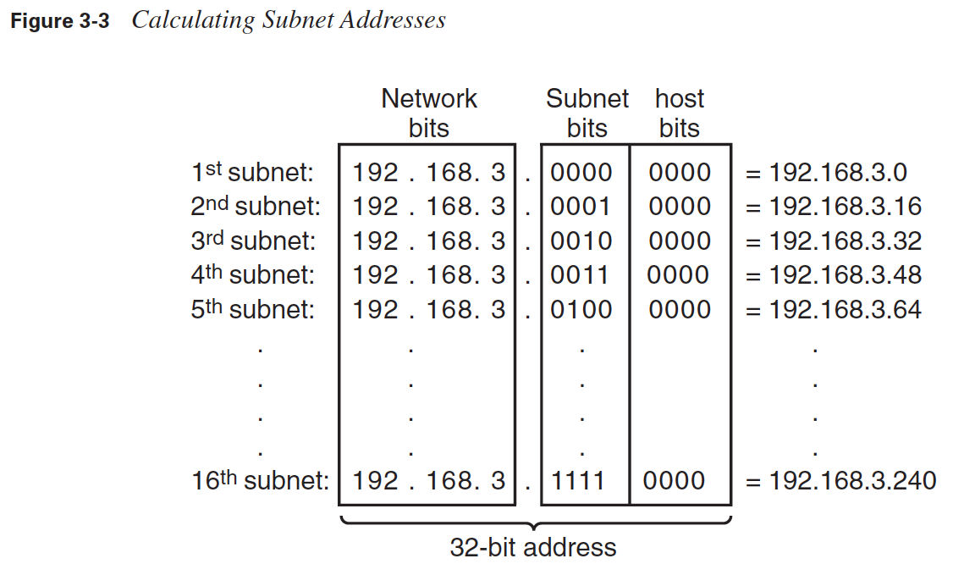
Determining the Subnet Mask to Use
Thus, the first subnet address that can be used with a mask of 255.255.255.240 is 192.168.3.0; this can also be written as 192.168.3.0/28. The second subnet is 192.168.3.16/28, and so on.

Slide 23
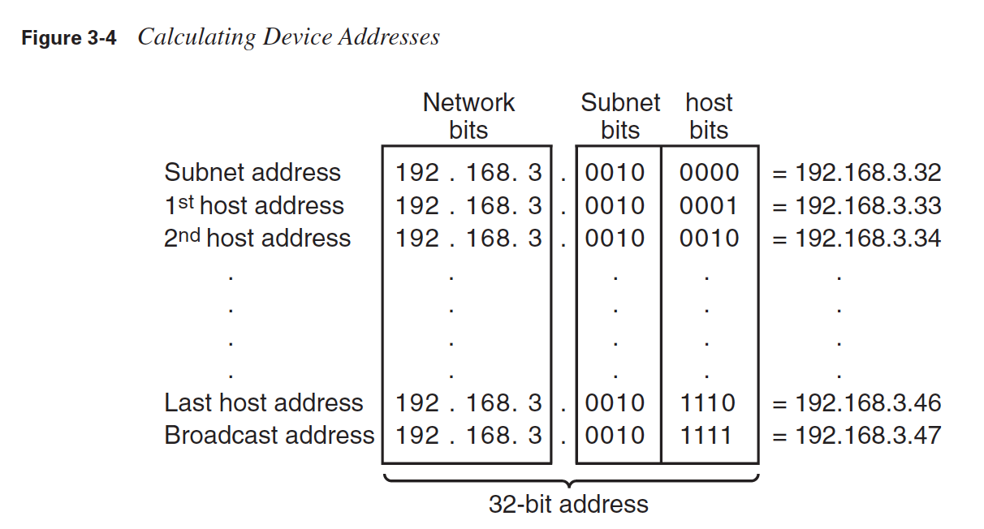
Determining the Subnet Mask to Use
Remember that the address in which all host bits are 0 is the subnet address, and the address in which all host bits are 1 is the broadcast address

